Slide 1
Building Binary Prediction Models through Regression
Adrianna Westbrook, MPH
Senior Biostatistician, Pediatric Biostatistics Core
Emory University School of Medicine

Slide 2
Outline
Introduction to predictive modeling and how it differs from hypothesis testing
Variable selection methods with SAS/R examples
Validation methods with SAS/R examples
Interpreting results and performance metrics of predictive models
Reporting prediction models in publications (based on TRIPOD recommendations)
Special considerations (sample size, missing data, collinearity)
Q&A and discussion

Slide 3
Introduction

Slide 4








A Brief History

Slide 5
Introduction to Predictive Modeling
“…uses known results to create, process, and validate a model that can be used to forecast future outcomes” – Investopedia
Data Source & Outcome to Predict
Variable Selection
Model Creation & Validation
External Validation & Implementation

Slide 6
Prediction Models & Algorithms
Classification:
Logistic regression – the focus of this presentation
Decision trees
Random forest
Neural networks
Other outcomes:
Continuous outcomes models
Clustering models
Outliers models
Time series models

Slide 7
Uses for Prediction Models
Healthcare sector
Patient outcomes: mortality, disease reoccurrence
Resource usage: ER visits, ICU bed shortage
Financial sector
Risk assessment: loan repayment, missed payments
Fraud detection: unlikely purchases
Retail
Promotional deals
Product positioning, sales schedule
Weather forecasting
What kind of outcomes do you want to predict?

Slide 8
Predictive Modeling vs Hypothesis Testing
Hypothesis testing: determining whether a relationship is meaningful or due to noise/chance
P-value is the focus
Establishing causality is often the long-term goal
Predictive modeling: estimating risk of an outcome or the outcome itself
Accuracy is the focus
Just because X predicts the occurrence of Y does not mean that X explains Y
“A p-value, or statistical significance, does not measure the size of an effect or the importance of a result.” – ASA Statement on P-values, 2016

Slide 9
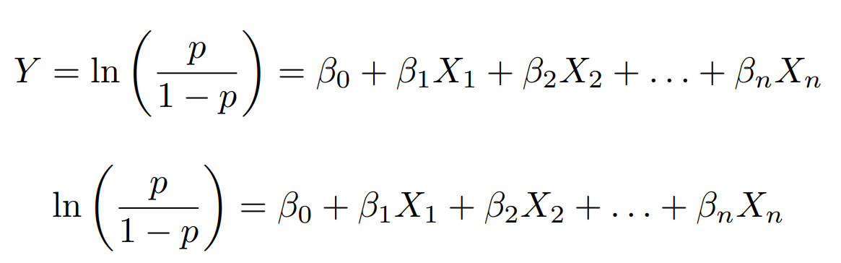
Logistic Regression
Often interested in determining the odds ratio for the occurrence of the event based on a variable of interest (i.e., Age, sex, race)
Probability of the event occurring

Slide 10
Variable Selection

Slide 11
Terms to Know
P-value: the probability under the assumption of no effect or no difference (null hypothesis), of obtaining a result equal to or more extreme than what was actually observed
How we define “statistical significance”
AIC/AICC/BIC: statistical measures that balance the goodness of fit of the model with the complexity of the model, penalizing models with more parameters to avoid overfitting
Lower values of AIC/AICC/BIC indicate a better fit
Mallow’s C_{p} statistic: the estimate of the prediction error of a model, adjusted for the number of predictors in the model
Values close to the number of predictors-1 indicate a better fit
Residual sum of squares (RSS): quantifies the discrepancy between the observed data and the model's predicted values
Lower values of RSS indicate better fit
Adjusted R²: the proportion of the variance in the dependent variable that is explained by the independent variables
Higher values of R² indicate better fit

Slide 12
Science Driven & Bivariate Method
Science or literature driven:
Conduct a literature review to identify predictors
Use clinical or other relevant knowledge
Should always be the first step
Bivariate method:
Conduct bivariate analysis (simple logistic regression) between each candidate variable and the outcome
Any variables under a certain p-value threshold are included in the final model
P-value threshold is usually 0.10 or 0.20
Disadvantage: based on p-values
Notes:
Talk about the apgar score

Slide 13
Stepwise Regression
Predictors are added or removed one at time if they are below a certain threshold (usually p-value below 0.10 to 0.20)
Forward:
Run y=x₁ through y=x_{k-1} and enter the x_{i} with the lowest p-value (assuming it is below the threshold)
Now run y=x_{i} + x₁ through y=x_{i} + x_{k-1} and enter the next x_{i} with the lowest p-value
Continue process until no more predictors come back with a p-value below the threshold
Backward:
Start with a full model (y=x₁ + … + x_{k-1}) and remove predictor with the highest p-value (assuming it is above the threshold)
Repeatedly remove the variable with the highest p-value until all remaining variables meet the stopping criteria (are below the threshold)
Notes:
Note that forward is for having a lot of variables whereas backwards works better with a smaller number of variables

Slide 14
Stepwise Regression
Bidirectional:
Combination of forward and backward
Perform the steps of forward stepwise but if a previously significant predictor loses significance, remove it from the model
Other types of selection criteria:
Adjusted R-square
AIC, AICC, BIC (R stepAIC use AIC)
Mallows’ C_{p} statistic
Residual sum of squares statistic (R regsubsets uses this one)
Schwarz BIC
Disadvantages of stepwise regression:
Prone to overfitting
Biased estimates
Notes:
Mention how stepwise regression does not handle collinearity well

Slide 15
Sample Dataset
Variable Name | Description | Levels/Range | Type
Mortality | Mortality within 60 days of hospital discharge | Yes/No | Binary
Cancer | Current cancer diagnosis | Yes/No | Binary
Prev_admiss | Previous admission in past year | Yes/No | Binary
Infection | Admitted for infection | Yes/No | Binary
Alert | Arrived to hospital alert | Yes/No | Binary
Sex | Sex of participant | Female/Male | Binary
Para_gt2 | More than 2 other children at home | Yes/No | Binary
Dist_100 | Distance to nearest hospital is less than 100 miles | Yes/No | Binary
Weight | Weight category based on BMI | Under/Normal/Over | Multicategorical
Educ | Main caregiver’s education | Less than high school/high school/college | Multicategorical
Dispo | Disposition upon leaving hospital | Discharged/Left AMA/Transferred | Multicategorical
Insurance | Insurance of participant | Private/Public/Self-pay | Multicategorical
Age | Age of participant, years | 3-17 | Continuous
Temp | Admission temperature, ˚F | 97-104 | Continuous
CRP | C-reactive protein, mg/L | 0.1-20 | Continuous
Oxygen | Admission oxygen saturation level, % | 60-100 | Continuous
Completely simulated based on real data
4,000 observations & 15 predictors
Outcome is mortality within 1 year of hospital discharge (~20%)

Slide 16
Best Subset
Quite literally making subsets of the data and using the “best” one
General steps:
Run every possible model fitting 1 to all possible predictors
You can limit number of potential predictors
2^{k}=total number of models where k=number of predictors
You will get the best fitting model within each category (i.e., 1 predictor model, 2 predictor model,..., k predictor model)
Then have to find the best fitting model between the best models from each category
Definition of best when choosing within categories:
Highest global score chi-square (used by SAS)
Highest R² (used by R)
Definition of best when choosing between categories:
Highest adjusted R²
Lowest Mallows’ C_{p} statistic closest to k-1
BIC
SAS won’t help you with the last step but R will identify the “best” based on those 3 categories
Notes:
This is a like “refined” all models selection approach. Like an all models approach, you (or better yet your program) are fitting every single possible model but unlike a general all models approach, you are applying some kind of criteria for what you consider best upfront– like the global chi-square score or highest R2, so you will get more refined results instead of all possible results.
Best subset is not recommended for large datasets due to the computational expense. In fact, SAS won’t even run past a certain number of variables.

Slide 17
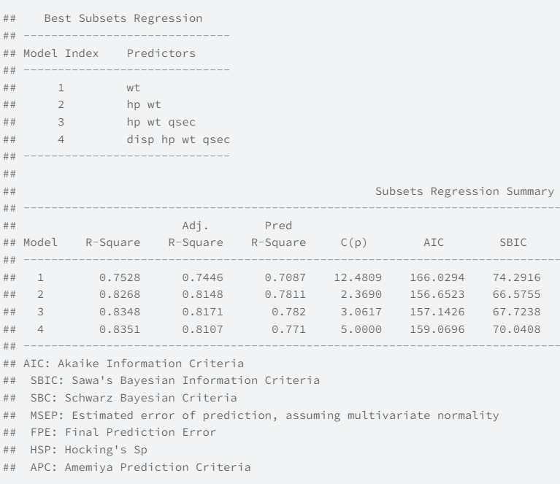
ols_step_best_subset() example

Slide 18
Regularization Techniques
Regularization techniques (LASSO, ridge, elastic net) adds a penalization that shrinks (or regularizes) coefficients down to reduce overfitting
 |  | LASSO (Least About Shrinkage and Selection Operator) | Ridge | Elastic Net
 | What | L-1 Norm, uses absolute value | L-2 Norm, uses squared value | Best of both worlds, L-1 and L-2 used
 | Pro’s | Reduces overfitting, will shrink coefficient to zero | Reduces overfitting, handles collinearity, can handle k>n | Reduces overfitting, handles collinearity, handles k>n, shrinks coefficients to zero
 | Con’s | Cannot handle k>n, doesn’t handle multicollinearity well | Does not shrink coefficients to zero, difficult to interpret | More difficult to do than the other two
Note: You do not get standard errors and p-values with regularization
Notes:
LASSO doesn’t handle multicollinearity well because it tends to randomly pick one of the effects and leave out the rest which may not be optimal for prediction.
Ridge regression should not be used for variable selection because it doesn’t perform variable selection but to talk about elastic net, we have to talk about ridge first. Because ridge does not shrink any of the coefficients to zero, just very close to it, you will still have all the predictors you threw in and you will have very small coefficients to interpret and deal with.
As more predictors are added in a model, this will increase the likelihood of overfitting the data. Which decreases the accuracy and quality of the model.
Regularization techniques is used to reduce regression estimates towards zero. Stepwise, backward and forward approaches procedure regression coefficient estimates that are too large in absolute value.
Lasso is used in SAS Proc GLMSELECT.
Reference Links: https://documentation.sas.com/doc/en/vdmmlcdc/8.4/vdmmlref/n13ok4xxdx6368n1x2rjo9tnr6w0.htm
Taken from notes from BUSPH BS 805:Intermediate Statistical computing and Regression analysis.
https://www.lexjansen.com/sesug/2019/SESUG2019_Paper-242_Final_PDF.pdf (p.12)

Slide 19
Regularization Techniques
Alpha determines which technique is used
Ranges from 0 to 1
1 = LASSO, 0 = Ridge, 0.5 = Elastic net
Lambda determines the amount of regularization applied
Range depends on software but 0 translates to essentially no regularization meaning the results will approximate an ordinary least-squares regression
Higher lambda encourages more shrinking but most shrinking is not necessarily the best fitting model
Value of lambda typically determined by cross-validation where the model that meets the criteria of importance is selected as the final model
Deviance (default)
AUC
Mean squared error

Slide 20
Training and Validation

Slide 21
Words to Know
Training: process of finding the model
Training set: the set you use to find the model
Validation: checking how the model you found in training fits on other data
Validation set: the data you use for validation
Note: “Testing” is sometimes used interchangeably with “validation” in some tutorials and documentation
Note 2: AUC is a performance metric we will discuss later but it will be used as the example during this section of the tutorial

Slide 22
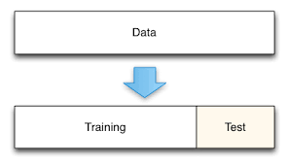
Words to Know
Internal validation: validating your model using data from the same source as your training data
Example: training and validation come from the same cohort of patients seen in a clinic from 2000-2020
External validation: validating your model using data from an entirely separate source of your training data
Example: training data is from patients of one clinic while validation data is from patients in a different clinic
Random split-validation: a form of internal validation where your data is randomly partitioned into training/validation sets
(often a 70/30 split)
Non-random split-validation: a form of internal
validation (debatable) where your data is
partitioned based on a non-random factor such as timing or location

Slide 23
Cross-validation (CV)
Considered a form of resampling validation, another type of internal validation
Is generally thought to be stronger than random split-validation
The process of partitioning the sample into test and training sets repeatedly to
Fine tune parameters (more applicable to ML)
Average performance (the application for today’s talk)
Multiple types of cross-validation such as:
Leave-one-out
K-fold cross-validation
Stratified K-fold cross-validation
Repeated K-fold cross-validation

Slide 24
Cross-validation General Set-up
Dataset is randomly split into training-test sets
Note: test is used to mean validation in a lot of online references about CV
Every group will serve as a training and test set at least once
In our application, this method is used to estimate an average performance of the model
Able to get stable estimates of model performance that are not being erroneously produced by overfitting
Can also be used for variable selection
Your final model estimates are calculated using the whole dataset

Slide 25
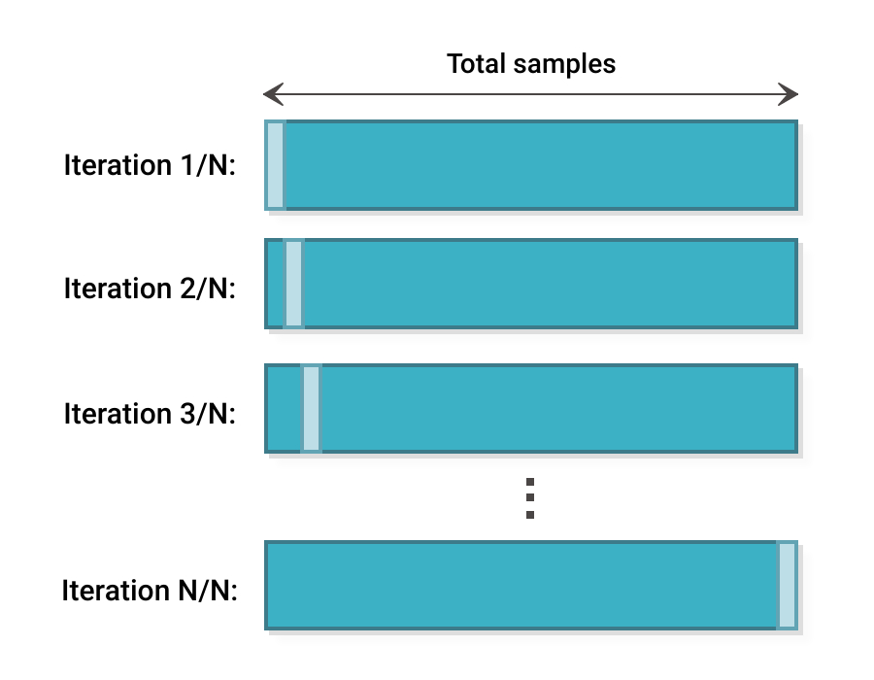
Leave-one-out Cross-validation
Each observation will act as the test set while the remaining observations are the training set
Procedure will be re-run N times where N=total number of observations
Quite computationally heavy and generally not recommended over the other types except with small datasets
Training
Test

Slide 26
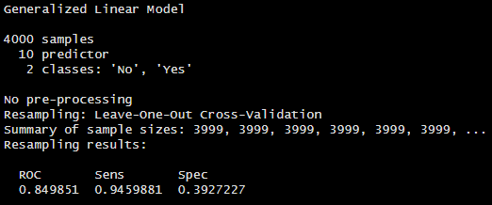
Leave-one-out Cross-validation Results
Assessed by setting the probability threshold to 0.50
This is a limitation that I have not found a good answer unfortunately

Slide 27
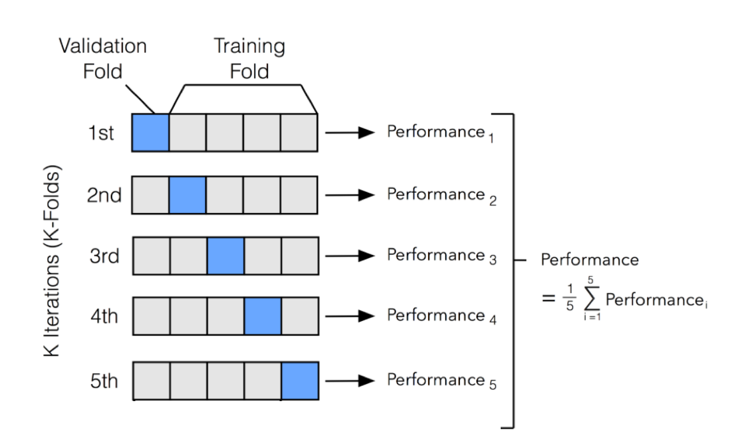
K-fold Cross-validation
Data is randomly divided into 5 or 10 groups
Each group serves as the test set once
Procedure runs K times K=number of folds (or groups) created
Great procedure and typically accepted by reviewers and stakeholders
Issues with sparse outcomes

Slide 28
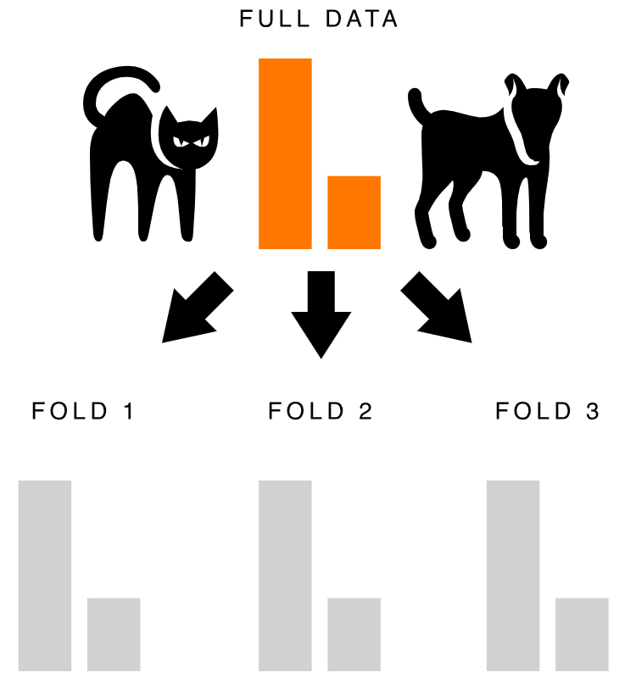
Stratified K-fold Cross-validation
When a small % of your data has the outcome, you could potentially randomly split the data so that one of your groups has none of the outcomes
To alleviate this issue, first stratify your data by the outcome and then do random selection so that each group maintains the original % of outcomes
20%
10%
20%
20%
20%
10%
10%
10%

Slide 29
Repeated K-fold Cross-validation
Repeat the process of regular K-fold cross-validation several times (typically 3, 5, or 10 times)
A 3-repeat 10-fold CV means partitioning the data so that there are eventually 30 groups
An improvement to regular K-fold CV but computationally heavy so only recommended for small-to-moderate sized sets
Repeat 3, 5, or 10 times

Slide 30
Choice of CV*
*All opinions are Adrianna’s and does not necessarily mean there is a right and wrong answer
Is your data set small
(N <30)?
Yes
Leave-one-out CV
No
Is your outcome rare (<20%)?
Yes
Stratified k-fold CV
No
Is your computer capable of running repeated CV given the data set size and complexity of the model?
Repeated K-fold CV
Yes
No
K-fold CV

Slide 31
Bootstrap Validation
Like CV, bootstrapping is considered a form of resampling validation and is generally considered stronger than random split-validation
Basic steps:
Resample the data with replacement so that the resampled dataset is as large as the original dataset.
Refit the same model to the resampled data and evaluate performance.
Evaluate the performance of the refit model on the original data set.
Take the difference between steps 2 and 3.
Repeat steps 1--4 about 200 times.
Take the average of the 200 differences and subtract it from the original index estimate to get a bias-corrected estimate of how the final model will perform on future data.

Slide 32
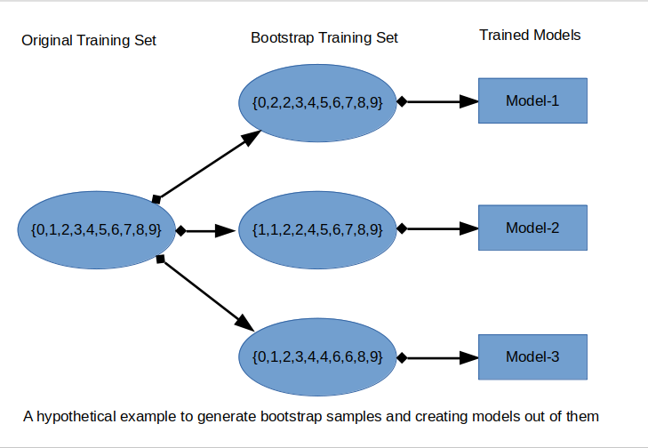
Bootstrap Validation Visualized

Slide 33
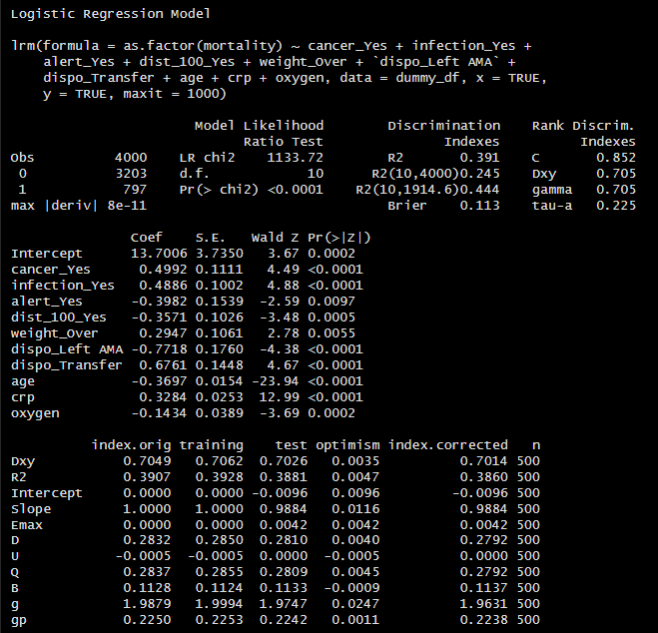
Bootstrap Results
You get several measures of interest
The one we will pay attention to is Dxy
Dxy = 2(C-0.5)
Where C is the C-index or AUC
Can back calculate to get the C-index

Slide 34
CV versus Bootstrap
Similarities:
Both a form of resampling validation
Differences:
CV is considered actual validation (testing performance in other datasets) whereas bootstrapping is considered estimating bias around a metric
CV will always produce datasets smaller than the original which loses power and precision
CV never evaluates the performance of the final model
CV is better known for validation
It’s really your choice. Just be clear in what method you use.

Slide 35
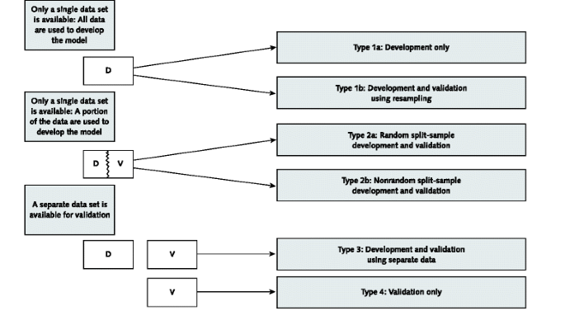
In Summary
Rank in strength:
1=strongest, 6=weakest
6
No validation
4
Internal validation
5
3
Arguably either one
2
External validation
1

Slide 36
Interpreting Results

Slide 37
Our Model
Used best subset limiting to 10 variables using the leaps package in R
Optimal model was the one with best Mallows’ C_{p}
Variable | Log Coefficient
cancer_Yes | 0.49925
infection_Yes | 0.48861
alert_Yes | -0.39820
dist_100_Yes | -0.35706
weight_Over | 0.29469
`dispo_Left AMA` | -0.77179
dispo_Transfer | 0.67606
age | -0.36972
crp | 0.32837
oxygen | -0.14342

Slide 38
Making Scores from Coefficients
Since probabilities can get down into the hundredth decimal places and worse, you may want to simplify the coefficients down to scores
A common method is to round the odds ratio to the nearest 0.5 and then double them
OR<1 are always set equal to -1
The final score is an addition of those coefficients
Variable | Log Coefficient | Odds Ratio | Score
cancer_Yes | 0.49925 | 1.647 | 3
infection_Yes | 0.48861 | 1.63 | 3
alert_Yes | -0.39820 | 0.672 | -1
dist_100_Yes | -0.35706 | 0.7 | -1
weight_Over | 0.29469 | 1.343 | 3
`dispo_Left AMA` | -0.77179 | 0.462 | -1
dispo_Transfer | 0.67606 | 1.966 | 4
age | -0.36972 | 0.691 | -1
crp | 0.32837 | 1.389 | 3
oxygen | -0.14342 | 0.866 | -1

Slide 39
Our Threshold
How to translate probability of outcome to categorizing them as having the outcome or not?
Arbitrary:
Could pick a threshold based on simple reasoning
A simple 0.50
Would you rather miss cases in exchange for not having any false positives? Increase the probability
Would you rather include false positives so you don’t miss any cases? Decrease the probability
Statistically Chosen:
Pick the threshold that optimizes sensitivity and specificity based on the highest Youden’s index
Youden’s index = sensitivity + specificity - 1

Slide 40
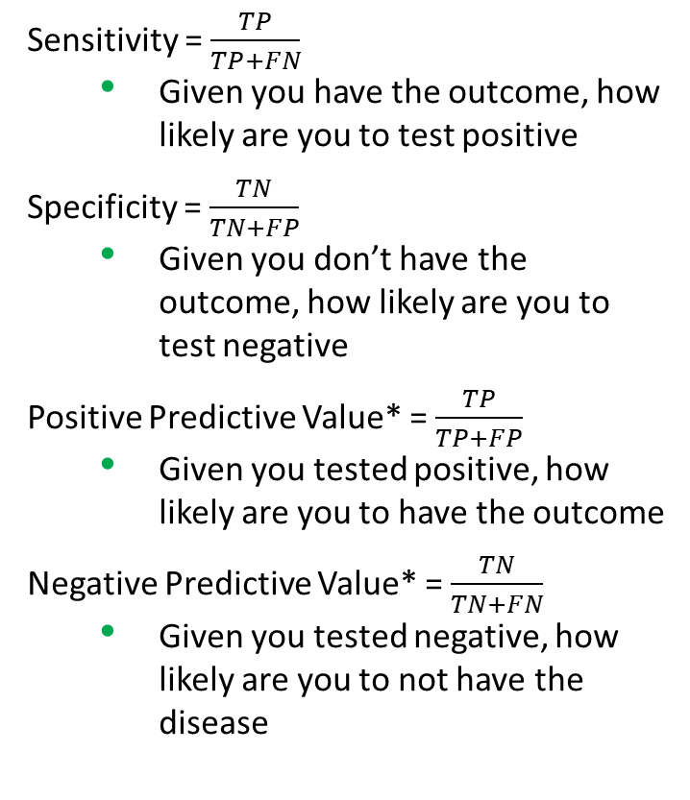
Diagnostic Accuracy
Sensitivity = $\frac{TP}{TP+FN}$
Given you have the outcome, how likely are you to test positive
Specificity = $\frac{TN}{TN+FP}$
Given you don’t have the outcome, how likely are you to test negative
Positive Predictive Value* = $\frac{TP}{TP+FP}$
Given you tested positive, how likely are you to have the outcome
Negative Predictive Value* = $\frac{TN}{TN+FN}$
Given you tested negative, how likely are you to not have the disease
 |  | Outcome
 |  | Positive | Negative
Test | Positive | True Positive (TP) | False Positive (FP)
 | Negative | False Negative (FN) | True Negative (TN)
In general,
↑ sensitivity, ↑ false positives, ↓ false negatives
↑ specificity, ↑ false negatives, ↓ false positives
↑ sensitivity, ↓ specificity and vice versa
SNOUT: Sensitive test when Negative rules OUT the outcome
SPIN: Specific test when Positive rules IN the outcome
*Depends on prevalence

Slide 41
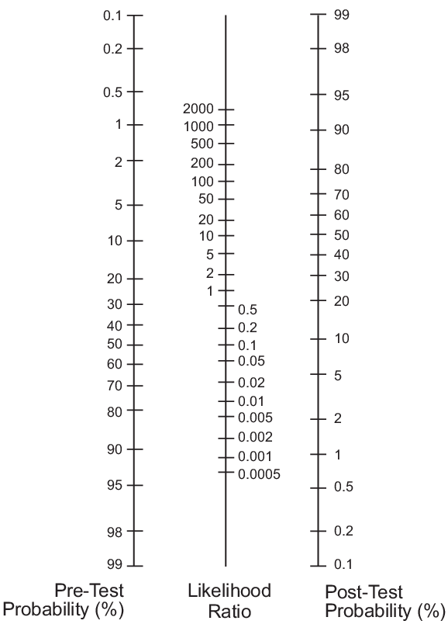
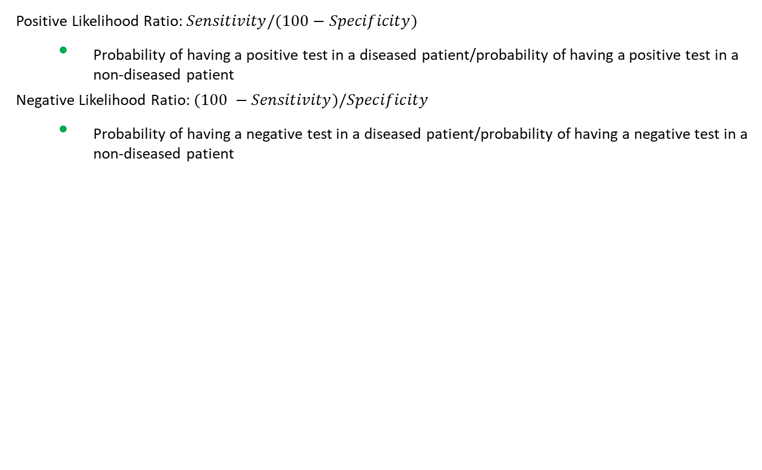
Diagnostic Accuracy
Positive Likelihood Ratio: $Sensitivity/(100−Specificity)$
Probability of having a positive test in a diseased patient/probability of having a positive test in a non-diseased patient
Negative Likelihood Ratio: $(100 −Sensitivity)/Specificity$
Probability of having a negative test in a diseased patient/probability of having a negative test in a non-diseased patient
Likelihood ratio | Change in likelihood of outcome after test
>10 | Large increase
5 - 10 | Moderate increase
2 – 5 | Small increase
1 – 2 | Minimal increase
1 | No change
0.5 – 1.0 | Minimal decrease
0.2 – 0.5 | Small decrease
0.1 - 0.2 | Moderate decrease
<0.1 | Large decrease

Slide 42
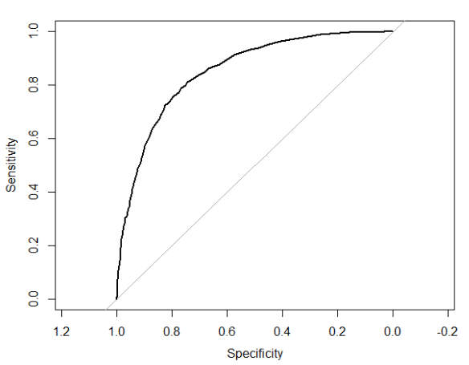
Overall Model Performance
AUC (C-index): Area Under the ROC (a plot of sensitivity and specificity)
Technical definition: the probability that somebody with the disease will have a higher test score than somebody without the disease
prob₃
AUC | Meaning
<0.5 | Worse than a coin flip, very poor rule
0.5-0.7 | Poor discrimination
0.7-0.8 | Acceptable discrimination
0.8-0.9 | Excellent discrimination
>0.9 | Outstanding discrimination
prob₂
prob₁

Slide 43
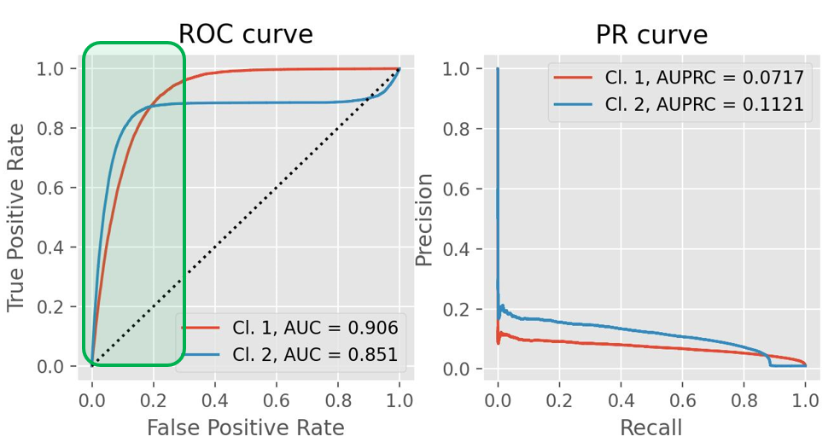
Overall Model Performance
AUPRC: Area Under the Precision-Recall Curve
Precision-Recall Curve: a plot of precision (positive predictive value) against recall (sensitivity) for different threshold values
Good for imbalanced datasets where the outcome is rare
An AUPRC close to or above the % outcome means a good classification
Hosmer-Lemeshow Test: test of goodness of fit for logistic regression
Overfitting, poor power, only tells you if it is a “bad” fit

Slide 44
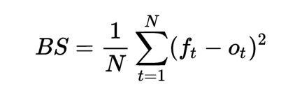
Overall Model Performance
Brier score: evaluates the accuracy of probabilities for binary outcomes
Where f_{t} is the estimated probability for that observation, o_{t} is the observed probability (1=occurred, 0=did not occur), and N is number of observations.
A score close to 0 indicates perfect prediction whereas a score close to 1 indicates complete opposite prediction.

Slide 45
Reporting Results

Slide 46
TRIPOD
Transparent reporting of a multivariable prediction model for individual prognosis or diagnosis
Can be accessed at: https://www.acpjournals.org/doi/10.7326/M14-0697
Table. Checklist of Items to Include When Reporting a Study Developing or Validating a Multivariable Prediction Model for Diagnosis or Prognosis*
Study population should be clearly defined including any limitations or strengths of that population
Definition of the outcome
Rationale for pursuing a predictive model and for the choice of potential predictors
How sample size and missing data was handled
The choice of variable selection and validation
The results of the model

Slide 47
Common Results to Report
The model itself and any score points you assigned the model
AUC/AUPRC
Other measures of performance such as R², results of Hosmer-Lemeshow test, Brier score
Optimal threshold along with diagnostic accuracy measures
It’s good practice to include other thresholds too
If using a validation method that produces two sets of results for training and validation sets, report results from both

Slide 48
Special Considerations

Slide 49
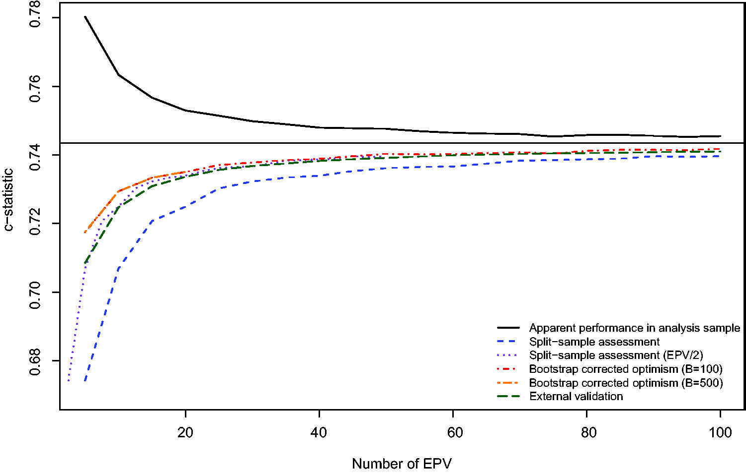
Sample Size
Rule of thumb is 10 events per candidate predictor parameter
Candidate means total variables considered, not just used (this is to prevent overfitting in variable selection methods such as stepwise selection where included variables are not limited)
Predictor parameter takes into account multilevel categorical variables
A 4-level categorical variables counts as 3 parameters

Slide 50
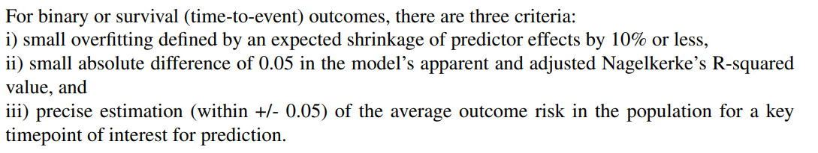
Sample Size
Riley et al came up sample size calculators for R and Stata
(https://www.bmj.com/content/368/bmj.m441)
pmsampsize(type = "b", csrsquared = 0.288, parameters = 24, prevalence = 0.174)
pmsampsize(type = "b", cstatistic = 0.89, parameters = 24, prevalence = 0.174)
Output will give different sample sizes that meet the different criteria
The safest option is the largest sample size
Authors recommend reducing candidate variables if given sample sizes are not feasible
Notes:
Reference: Riley R D, Ensor J, Snell K I E, Harrell F E, Martin G P, Reitsma J B et al. Calculating the sample size required for developing a clinical prediction model BMJ 2020; 368 :m441 doi:10.1136/bmj.m441

Slide 51
Missing Data
Consider why a variable is missing and how much of it is missing
Does it make sense that missingness can be its own category for prediction? i.e., unknown insurance status may relate to willingness to call ambulance and therefore could be a helpful predictor
Consider removing variables with high rates of missingness – if the variable is often missing, how useful would it truly to be to users of your model?
Could potentially use complete-case analysis (removing any observations missing any data) for MCAR situations but that could substantially reduce your sample size
Multiple imputation (MI) is a valid way to handle all types of missingness (MCAR, MAR, MNAR)
Variable selection becomes tricky with MI because we now have multiple slightly varied datasets that could lead to different selections

Slide 52
Missing Data (Multiple Imputation)
An extremely brief explanation of multiple imputation (MI):
MI is the process of filling in missing data by creating multiple datasets where the missing values are filled in with plausible data but the datasets vary from one another in a way that simulates the variety seen in real data
Steps (normally):
Determine method for filling in datasets (FCS, MICE, etc.)
Create 5-10 of the MI datasets
Run the same model in each of the MI datasets
Combine the coefficients through a method such as Rubin’s Rules to get a single, usable model with coefficients and confidence intervals

Slide 53
Missing Data
RR still works for cases where you did not use software for variable selection
Otherwise, the following options are available to you (based on work by Wood et al [link in notes]):
Type | Name | Description
Separate imputations | S1 | select predictors that appear in any model
 | S2 | select predictors that appear in at least half of the models
 | S3 | select predictors that appear in all models
Stacked set with weighted regression | W1 | w_{i}=1/M. These weights scale the log likelihood for the stacked data to the equivalent of a data set of length n but ignore the degree of missing information
 | W2 | w_{i}=(1−f)/M where f, the average fraction of missing data across all variables, is calculated as (total number of missing values across all variables) divided by pn
 | W3 | w_{i}=(1−f_{i})/M where f_{i}, the fraction of missing data for variable X_{i}, is calculated as (number of missing values for variable X_{i}) divided by n
M=number of MI sets, n=number of individuals, p=number of predictors/variables
Notes:
https://onlinelibrary.wiley.com/doi/abs/10.1002/sim.3177?casa_token=HHkVIMnq1DgAAAAA:3hWF0qstXPVBM8VL0c44LNUCif_m8fuO5DlWGfZppNuhBdgFemTuKVrN5PQOURARokgprJIHoP8d
Wood, A.M., White, I.R. and Royston, P. (2008), How should variable selection be performed with multiply imputed data?. Statist. Med., 27: 3227-3246. https://doi.org/10.1002/sim.3177

Slide 54
Collinearity
Collinearity is the correlation or linear relationship between two or more variables in a regression model
This is problematic for inference and hypothesis testing due to the instability of the estimates and inflated standard errors
However, we are less concerned about it with prediction modeling*
We are more concerned with the predicted probability than the influence of the predictor itself
Some variable selection methods directly handle collinearity
Don’t forget about good old factor analysis
An example:
You want to predict shirt size so you collect information on torso length and arm length. Torso length and arm length are typically correlated.
By including them both, the model may incorrectly assign a coefficient of 0.5 to arm length and 0.1 to torso length (when it should have been the opposite or some other, equal combination)
Does it matter for us if the predicted probability is still correct?
*If the correlation between variables seen in your dataset is not true to the other populations your model is applied to, then it is a bigger concern

Slide 55
Things to Keep in Mind
With any modeling, consider the bias of your collected variables
Bad input=bad output
It is common practice to have an “other” level for categorical variables
I.e. White, Black, Other for race
It is possible for the “other” variable to be selected in variable selection so be prepared to define and defend what “other” means
As William Baumol (1992) observes, “A well-designed model is, after all, a judiciously chosen set of lies, or perhaps more accurately put, partial truths about reality, which have been chosen so as to permit us to reason more effectively about some issue than we otherwise could. The model must be an oversimplification if it is to be tractable analytically. Optimality model constructions must be based on the trade-off between these two desiderata—accuracy of representation of reality and usability in analysis.”

Slide 56




Questions? Let’s discuss!
Contact info: Adrianna Westbrook at alwestb@emory.edu
I would greatly appreciate your feedback!
http://tinyurl.com/nolacsp24

